Slide 1
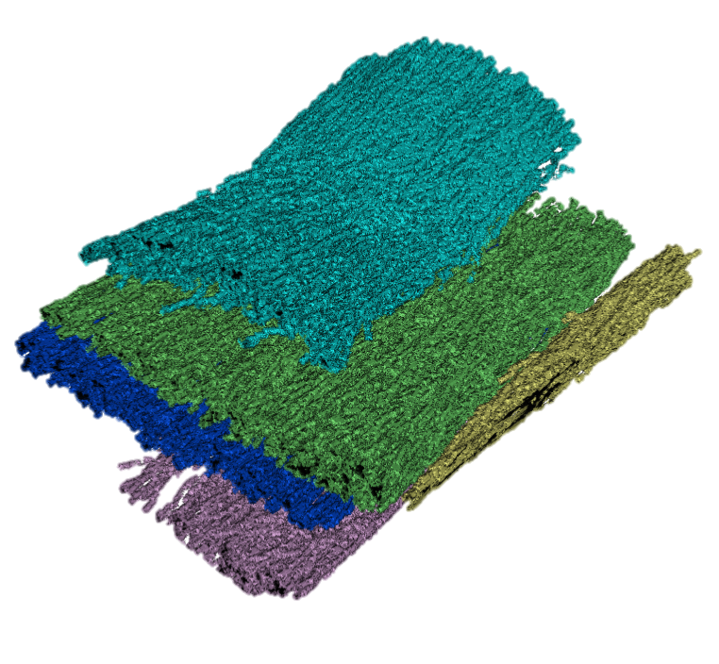
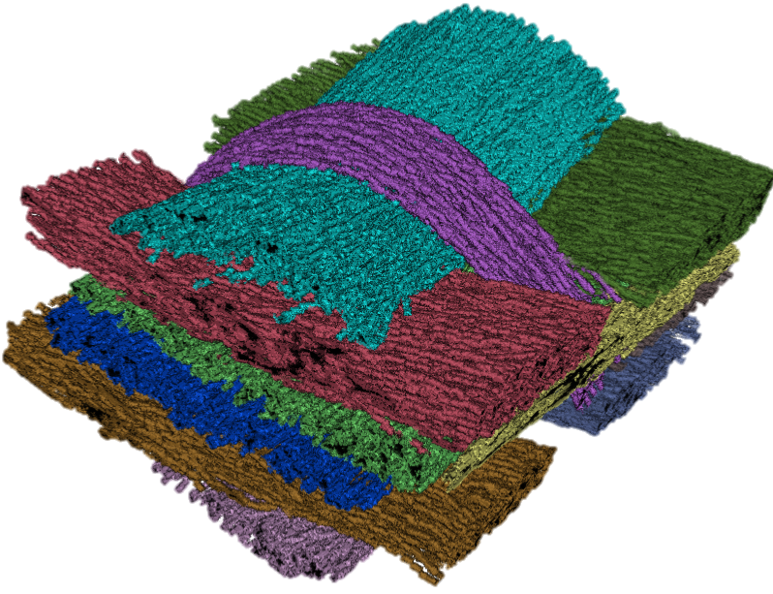
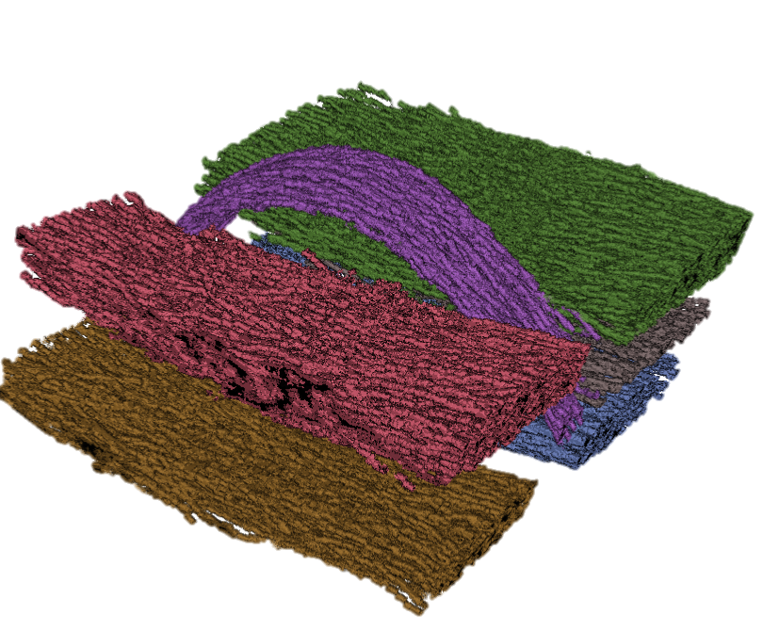

Clusters From Orientation 1
1
1
2
4
3
2
4
3
5
Clusters From Orientation 2
5
1
1
2
2
3
3
6
4
B
5
4
5
Combined clusters
6
A

Slide 2
Clusters From Orientation 1
1
1
2
4
3
2
4
3
5
Clusters From Orientation 2
5
A
B
Combined clusters

Slide 3
Clusters From Orientation 1
1
1
2
4
3
2
4
3
5
Clusters From Orientation 2
5
A
B
Combined clusters

Slide 4
Clusters From Orientation A
Clusters From Orientation B
1
1
1
1
2
2
2
3
3
6
3
2
4
4
3
4
5
5
4
5
5
6
A
Bundles per Orientation
A
B
Combined clusters

Slide 5
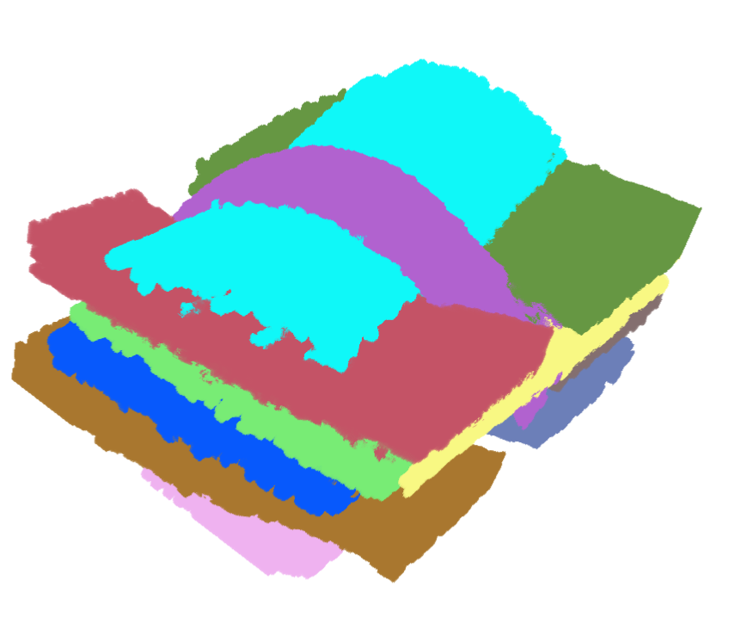
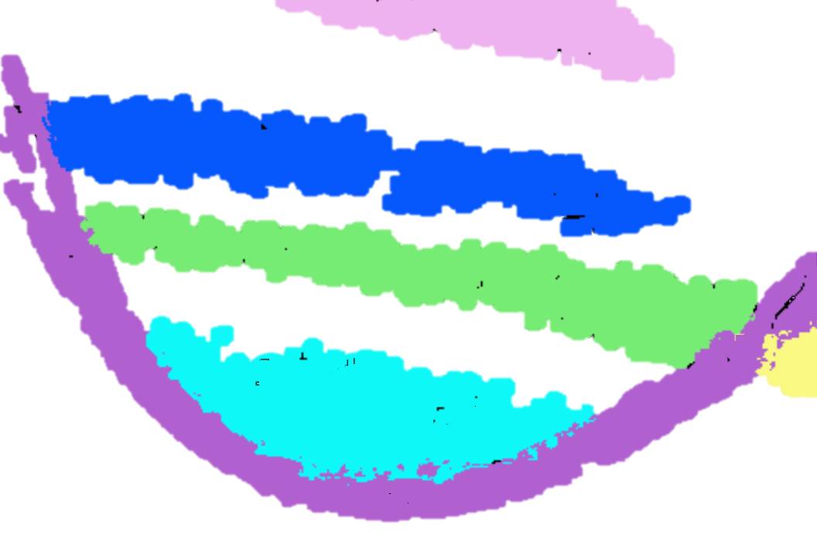
A
B
Fiber bundles volume
Single slice of volume

Slide 6
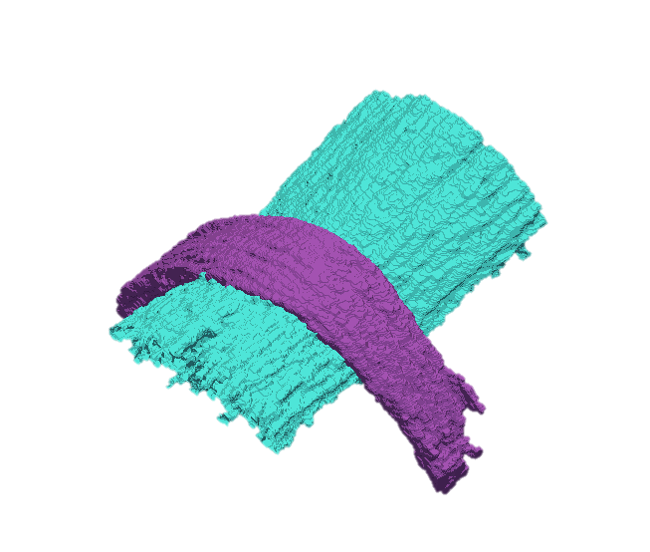
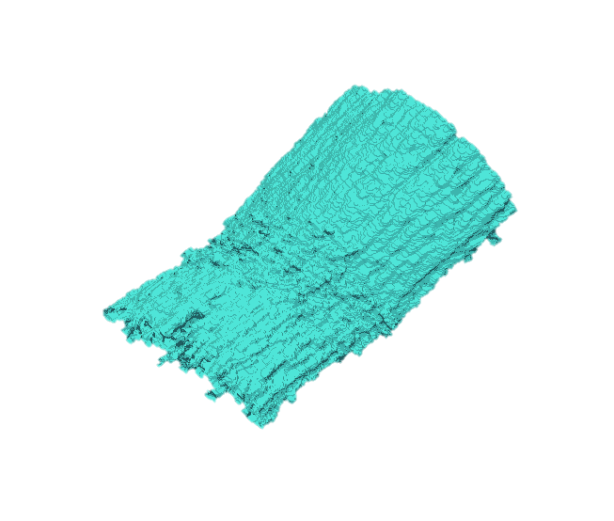
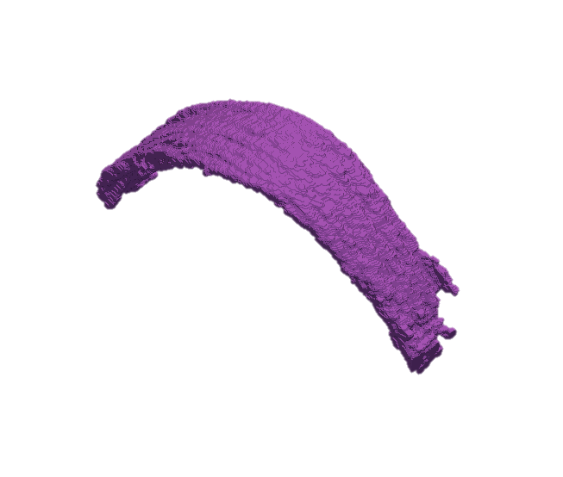
C
D
Fiber bundles volume
Single slice of volume
1
1
1
1
F
Individual surface mesh
E
Combined surface mesh

Slide 7
A
Fiber bundles volume
Single slice of volume
B
7
7
C
7
7
D
Individual surface mesh
Combined
surface mesh

Slide 8
A
B
Fiber bundles Volume
Single Slice of Volume
7
7
C
D
7
7
Combined Mesh
Individual Mesh

Slide 9
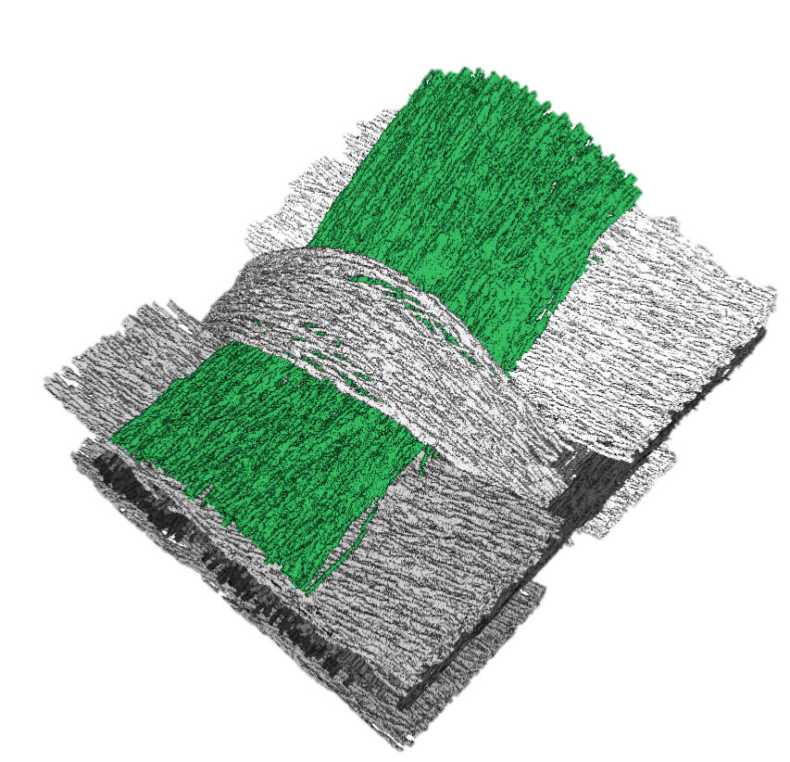
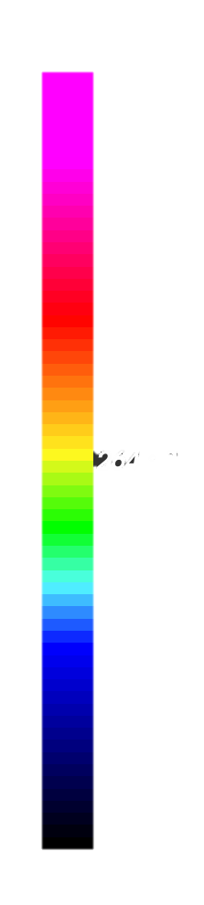
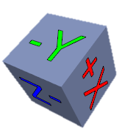
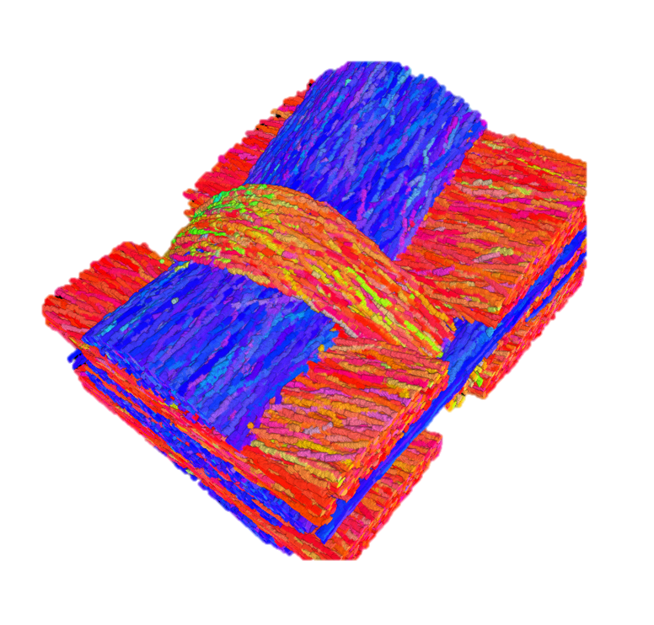
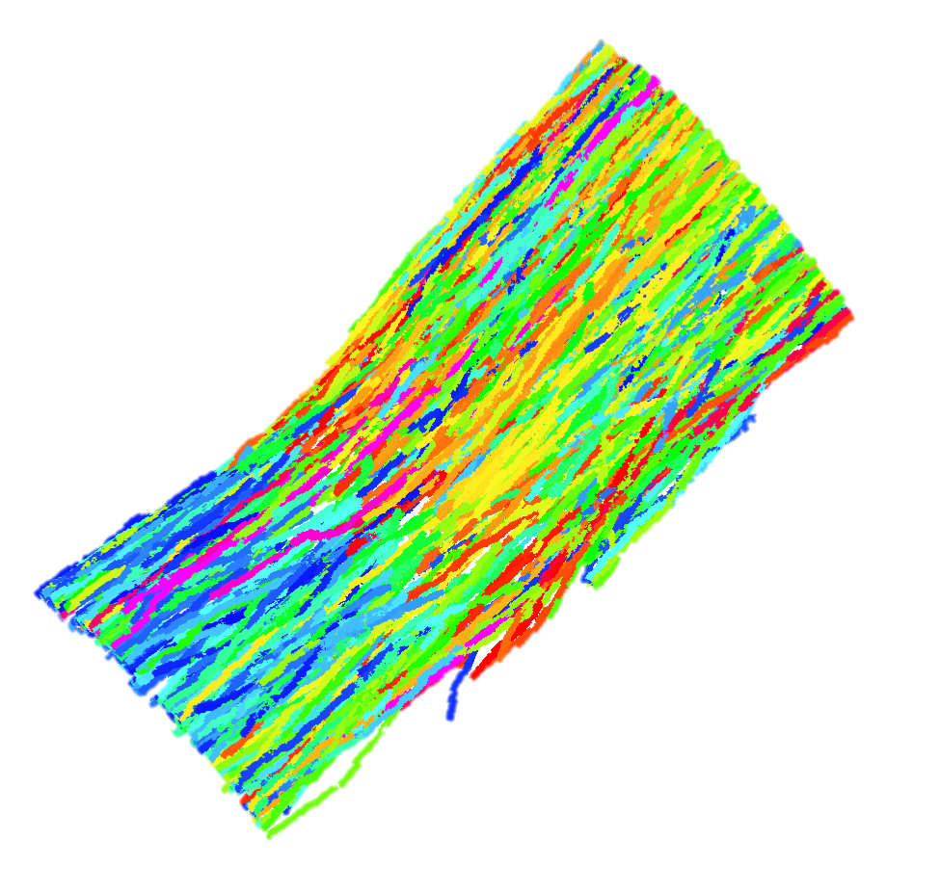
MetaTracts color mapped to major axis direction
Length Distribution of fibers in bundle 1
A
B
1
529
396
264
132

Slide 10
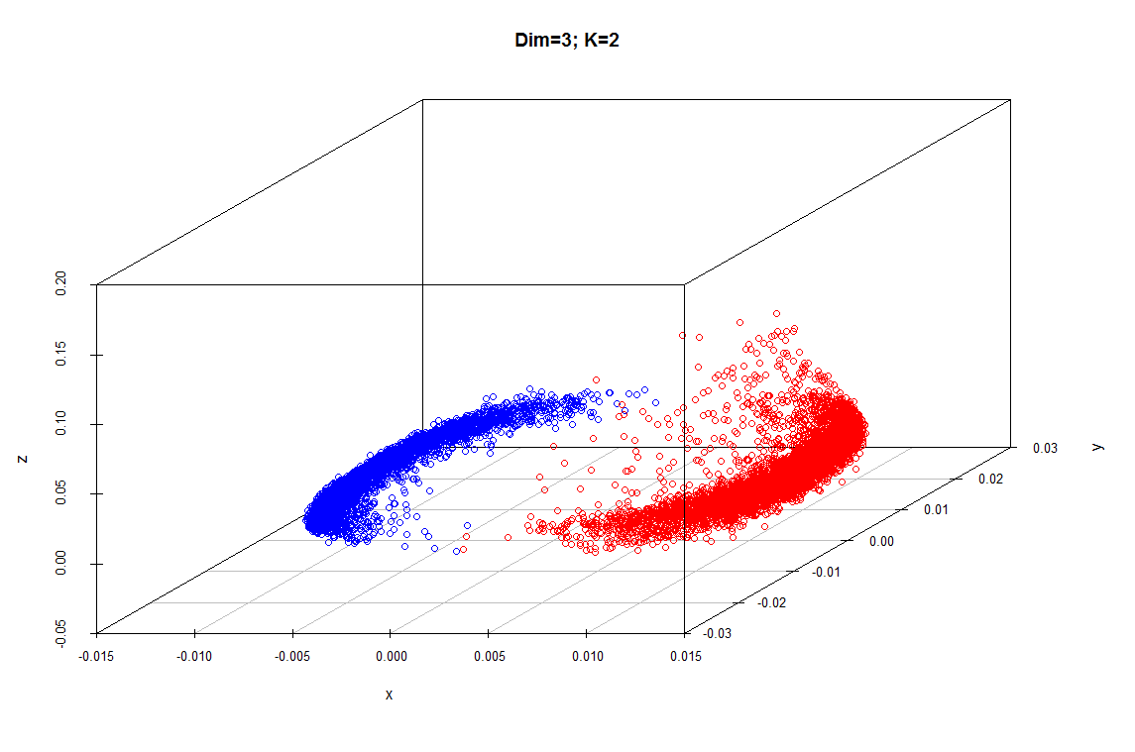
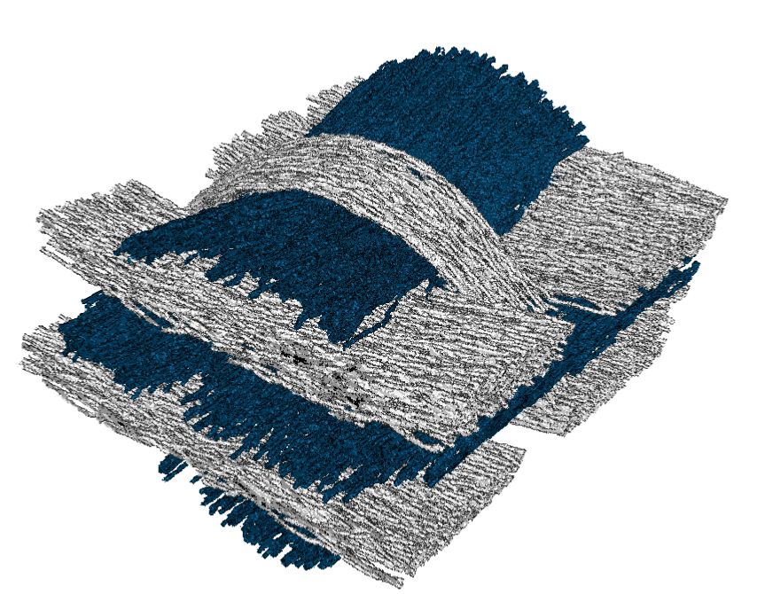
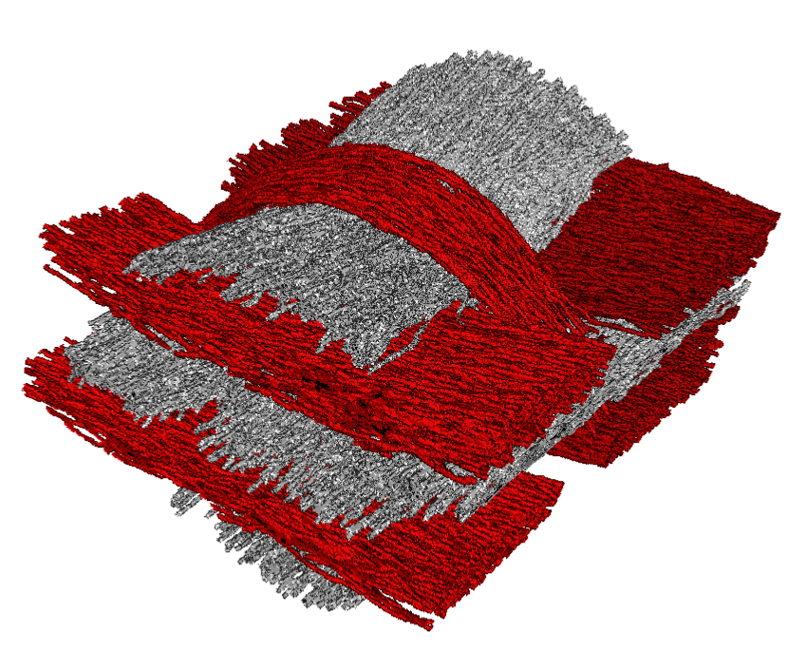
MetaTracts projected on top three eigenvectors and clustered into 2.
A
C
B
Eigenvector 3
Eigenvector 2
MetaTracts in
Cluster 2
MetaTracts in
Cluster 1
Eigenvector 1

Slide 11
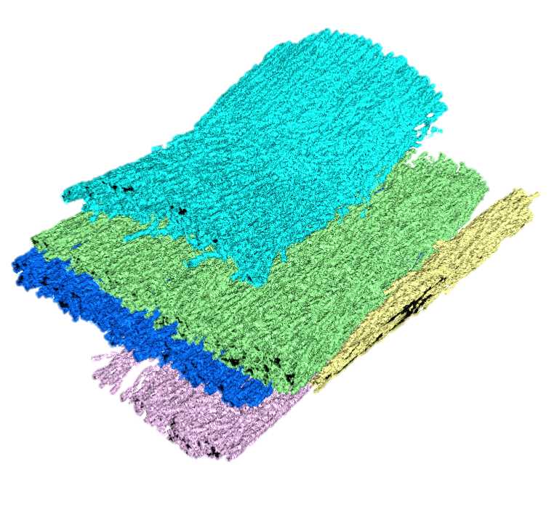
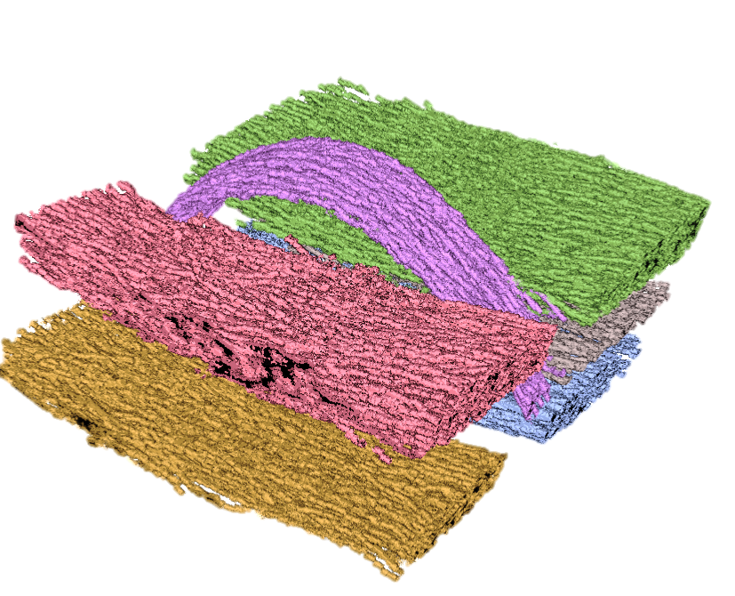
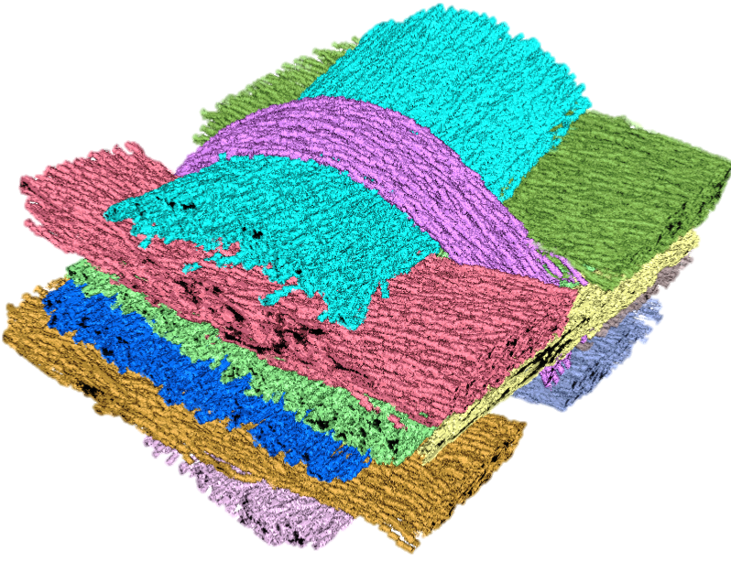
A
B
C
Eigenvector 3
Eigenvector 2
MetaTracts in
Cluster 1
MetaTracts in
Cluster 2
Eigenvector 1
MetaTracts projected on top three eigenvectors and clustered into 2.
D
E
7
1
5
2
6
8
3
9
4
11
10
F

Slide 12
A
B
C
Eigenvector 3
Eigenvector 2
MetaTracts in
cluster 1
MetaTracts in
cluster 2
Eigenvector 1
MetaTracts projected on top three eigenvectors and clustered into 2.
D
E
7
1
5
6
2
8
3
9
4
11
10
F

Slide 13
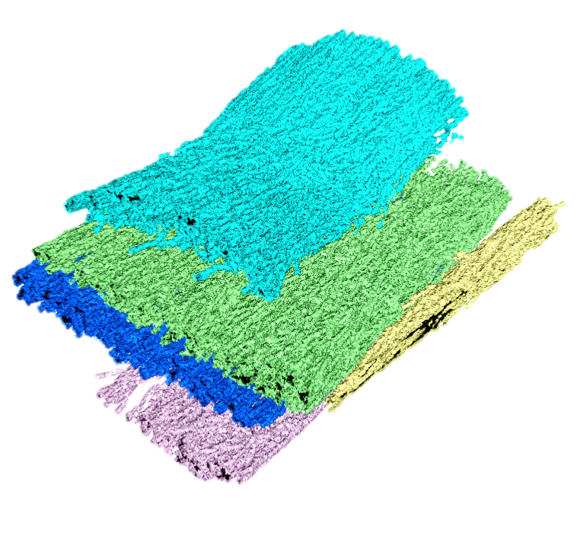
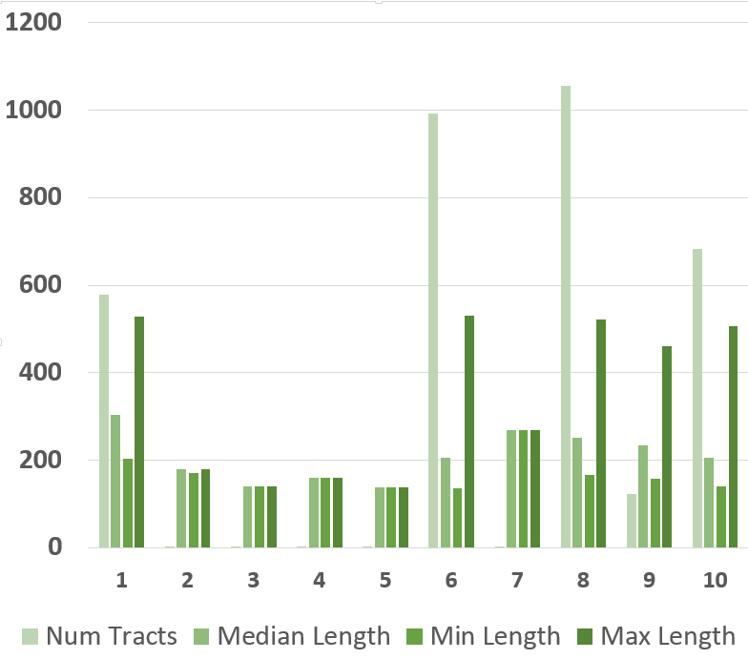
6
9
10
8
1
X Axis : Fiber Bundle clusters of orientation A. Unit for length is unit cube length.

Slide 14
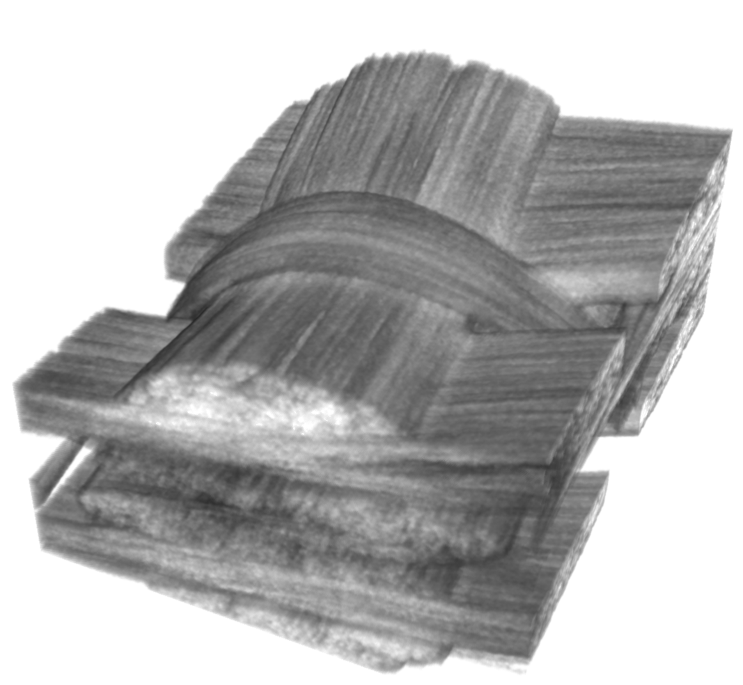
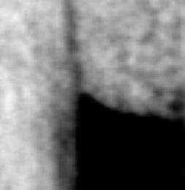
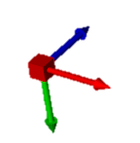
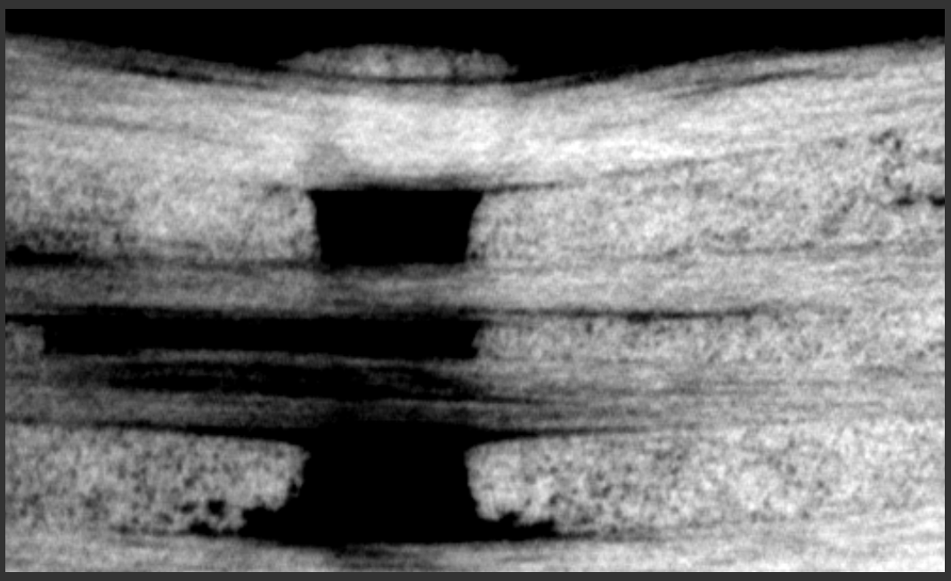
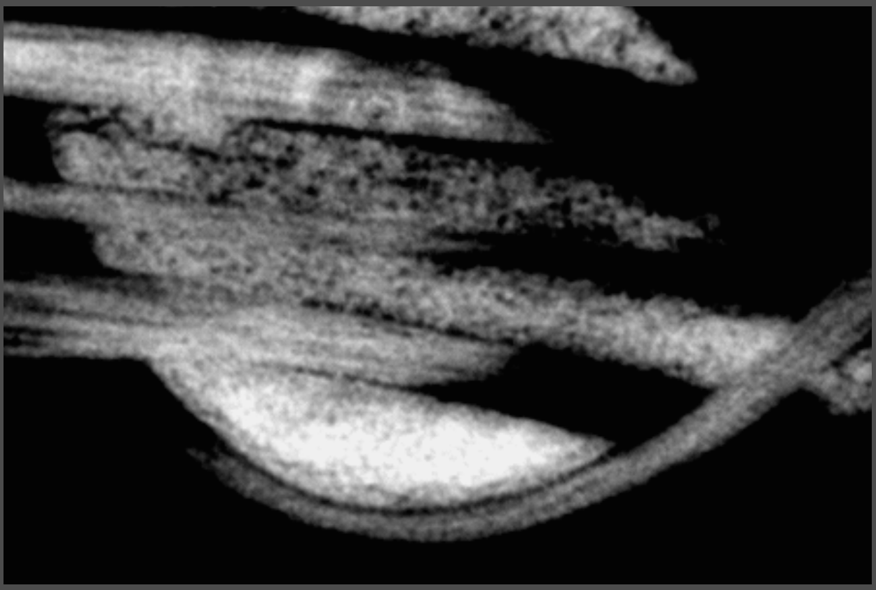
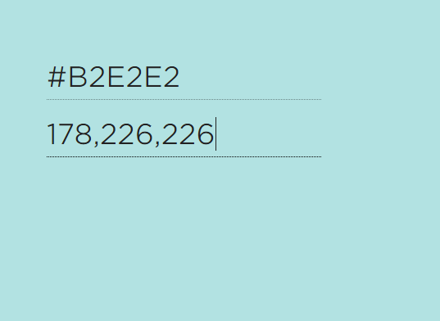
A
Y Z Plane
D
X Y Plane
X axis
B
C

Slide 15
A
Y Z Plane
D
X Y Plane
X axis
B
C

Slide 16
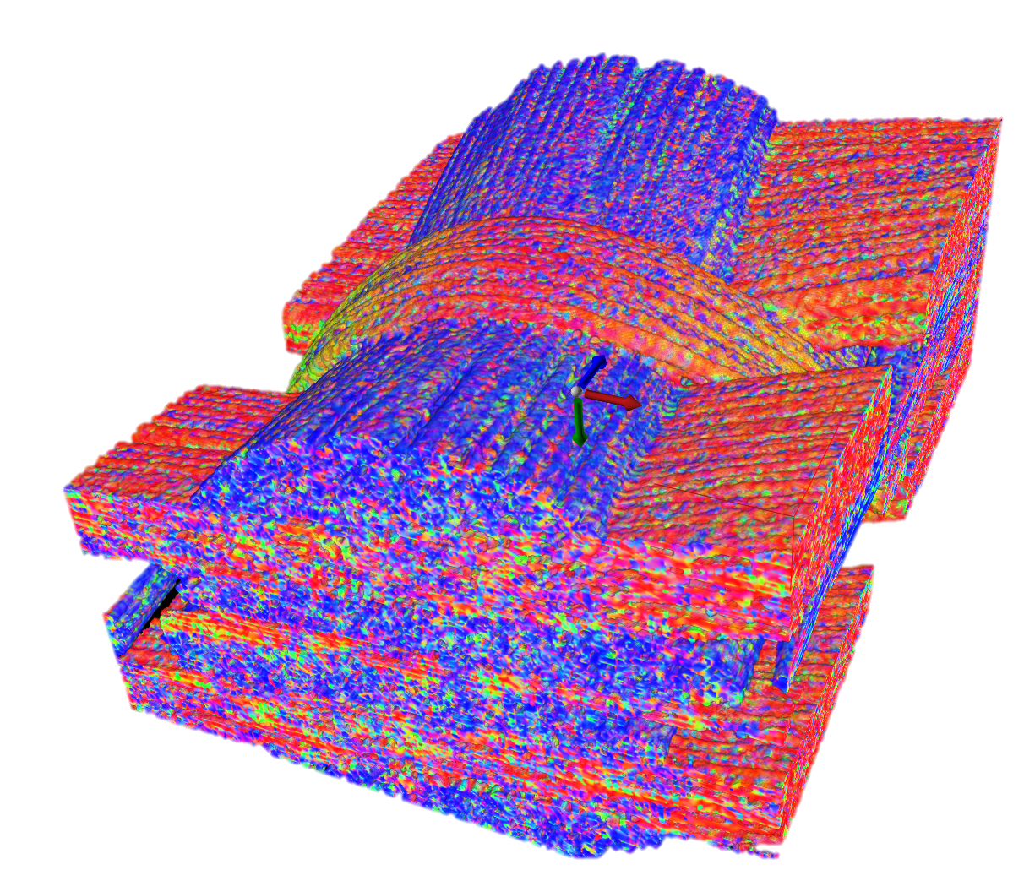
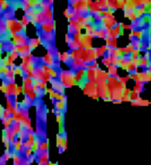
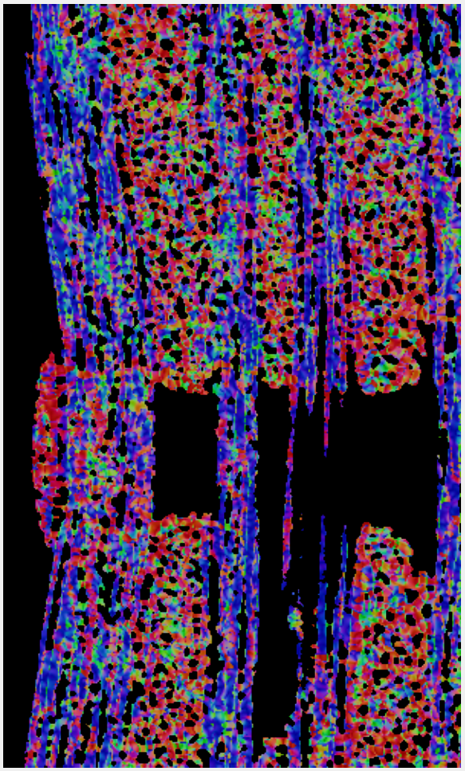
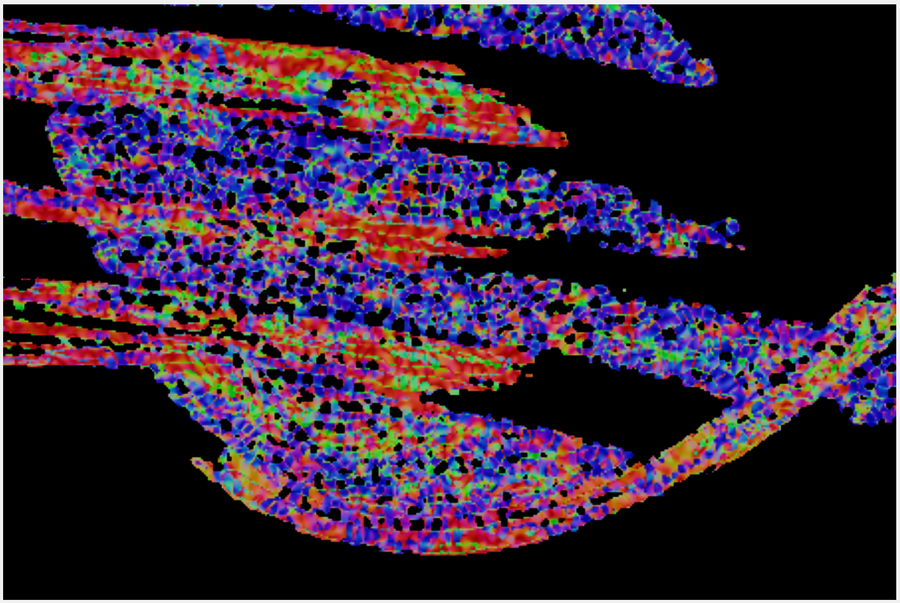
A
Y Z Plane
D
X Y Plane
B
C

Slide 17
A
Y Z Plane
D
X Y Plane
B
C

Slide 18
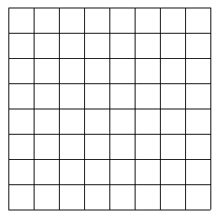
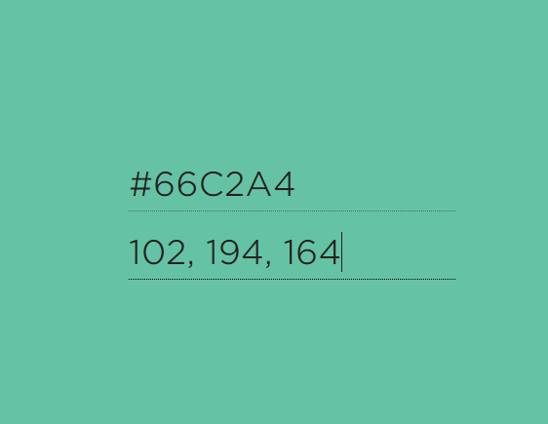
A
2R
N_{P}
L
C_{P}
Dist
B
C

Slide 19
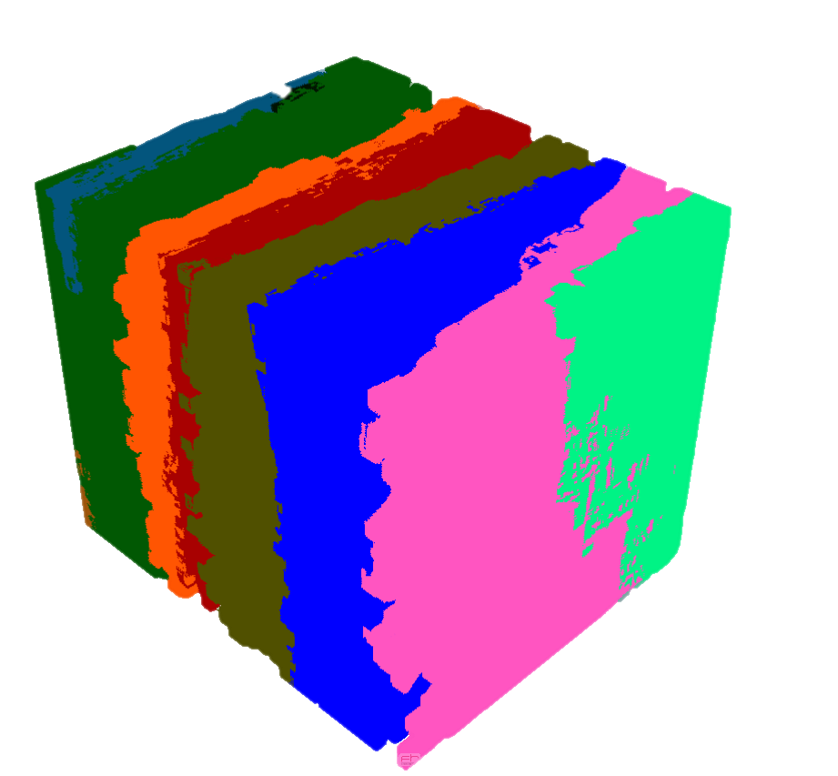
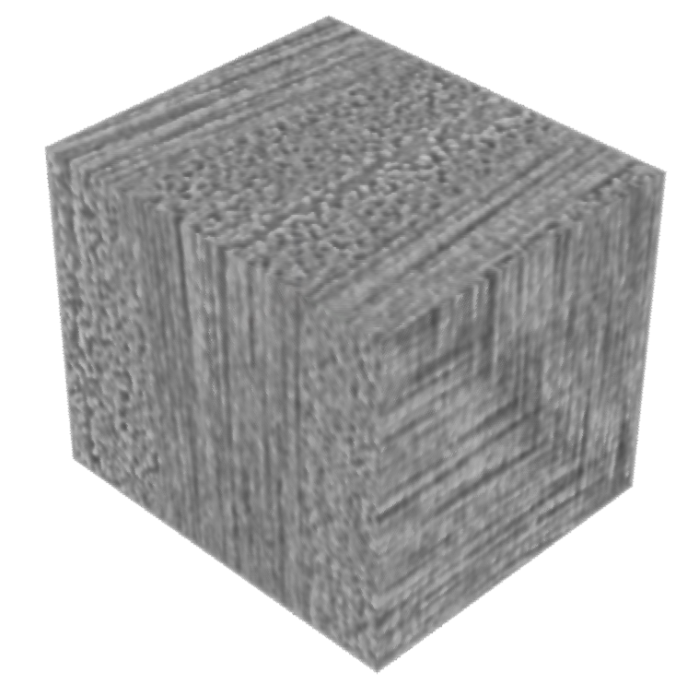
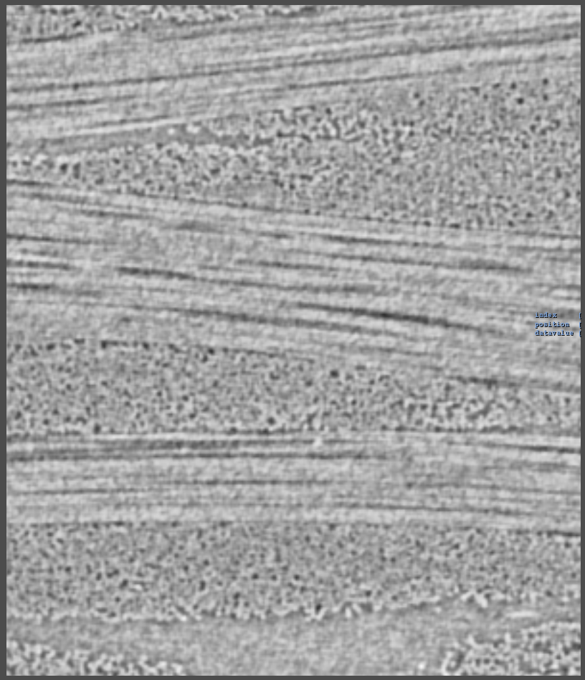
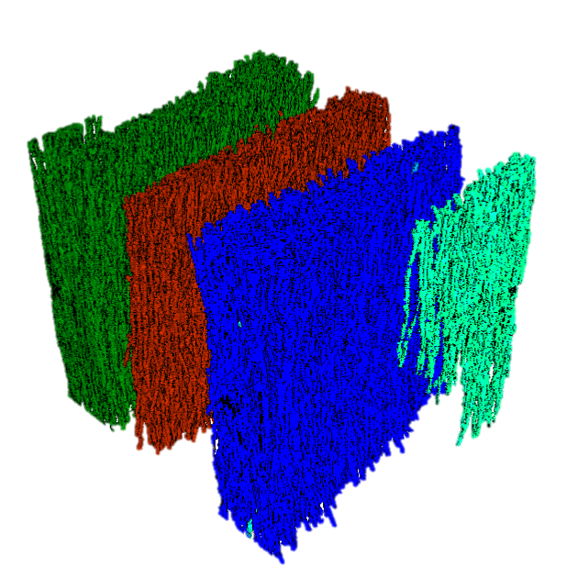
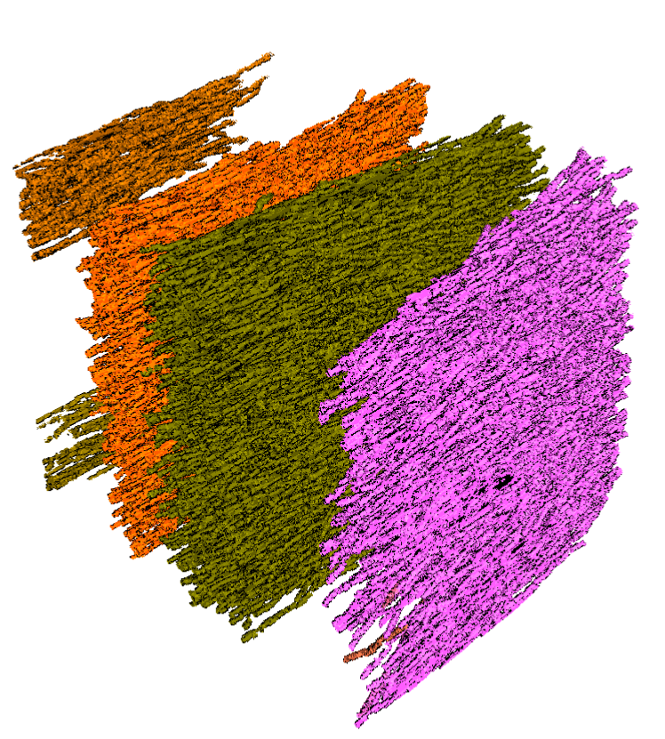
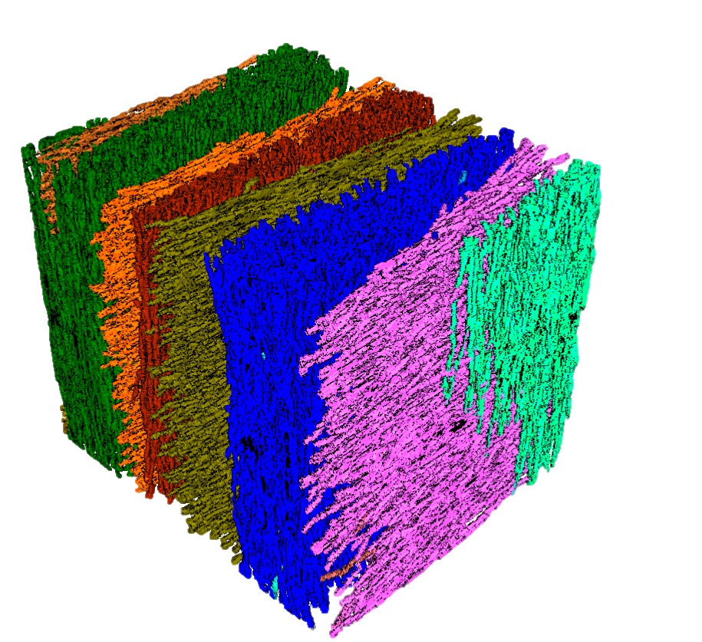
Scalar Data
Volume Visualization
A
D
B
C
Individual Orientation clusters
Combined clusters

Slide 20
A
Scalar data
D
Volume visualization
B
Individual orientation clusters
C
Combined clusters

Slide 21
A
Scalar Data
D
Volume Visualization
B
Individual Orientation clusters
A
Combined Clusters

Slide 22
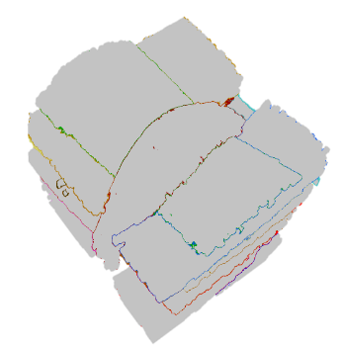
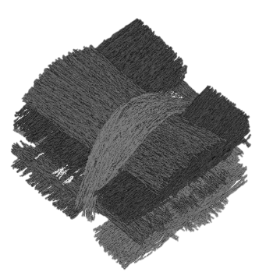
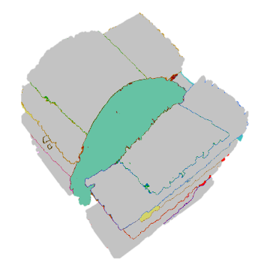



XCT data
Reliable Hessian
MetaTracts
Generation
Fiber Bundle Generation
Calculations
Scalar Data
Visualization

Slide 24
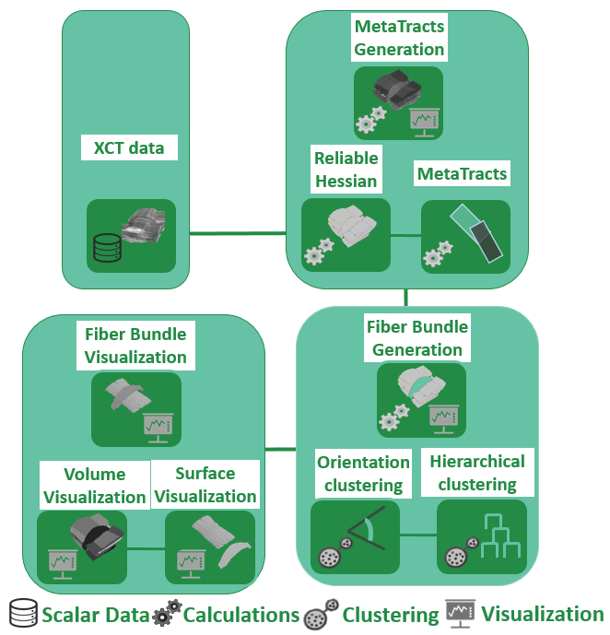
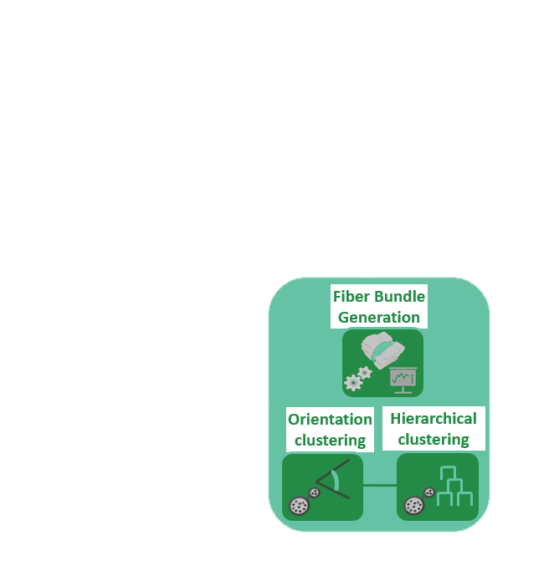

Slide 25
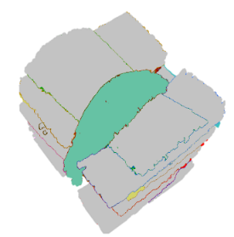
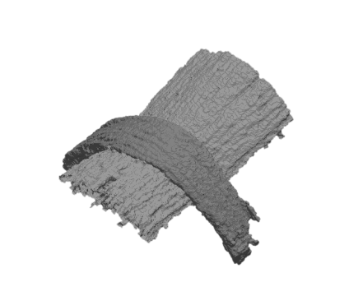
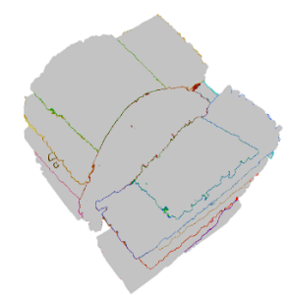
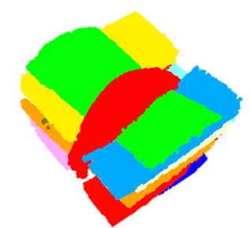



MetaTract Generation
Fiber Bundle Generation
Fiber Bundle Visualization
Reliable Hessians
MetaTracts
Orientation
Clustering
Hierarchical Clustering
Volume Visualization
Surface Extraction
Computations
data
Visualization
Clustering

Slide 26
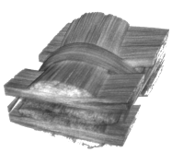
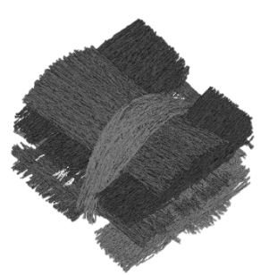









XCT Data
MetaTract Generation
Fiber Bundle Generation
Fiber Bundle Visualization
Reliable Hessians
MetaTracts
Orientation
Clustering
Hierarchical Clustering
Volume Visualization
Surface Extraction
Data
Computations
Clustering
Visualization

Slide 27
XCT Data
MetaTract Generation
Fiber Bundle Generation
Fiber Bundle Visualization
Reliable Hessians
MetaTracts
Orientation
Clustering
Hierarchical Clustering
Volume Visualization
Surface Extraction
Data
Computations
Clustering
Visualization

